Slide 1

Sampling Distributions

Slide 2
Sampling Distributions
Consider the data set:
x₁ = 2; x₂ = 3; x₃ = 4; x₄ = 5; x₅ = 6
Note: μ = 4
Regroup into 3:
Group1: 2,3,4 →
Group 2: 2,3,5 →
Group 3: 2,3,6 →
Group 4: 3,4,5 →
Group 5: 3,4,6 →
Group 6: 2,4,5 →
Group 7: 2,4,6 →
Group 8: 2,5,6 →
Group 9: 3,5,6 →
Group 10: 4,5,6 →
Mean of Means:

Slide 3
Sampling Distributions
Consider the data set:
x₁ = 2; x₂ = 3; x₃ = 4; x₄ = 5; x₅ = 6
Note: μ = 4
Regroup into 4:
Group1: 2,3,4,5 →
Group 2: 2,3,4,6 →
Group 3: 2,4,5,6 →
Group 4: 3,4,5,6 →
Group 5: 2,3,5,6 →
Mean of Means:

Slide 4


Sampling Distributions
3-samples
 | 3 | 3.3 | 3.7 | 4 | 4.3 | 4.7 | 5
 | 0.1 | 0.1 | 0.2 | 0.2 | 0.2 | 0.1 | 0.1
4-samples
 | 3 | 3.5 | 3.75 | 4 | 4.25 | 4.5
 | 0.2 | 0.2 | 0.2 | 0.2 | 0.2 | 0.2

Slide 5
Sampling Distributions
Probability distribution of a statistic
Population size
Sample size
Sampling Method
Sampling Distribution of the mean
The distribution that results when an experiment
is conducted over and over (always with a
sample size n)
Describes the variability of sample averages
about the population mean μ

Slide 6
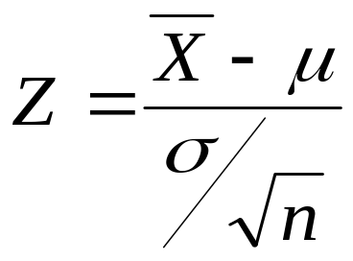
Central Limit Theorem
If X is the mean of a random sample of size n
taken from a population with mean μ and finite
standard deviation σ, then the limiting form
of the distribution of
as n → ∞, is the standard normal distribution
n(z;0,1)

Slide 7
Central Limit Theorem
The CLT simply means that the distribution of an
average tends to be Normal, even when the
distribution from which the average is computed
is decidedly non-Normal.
The CLT is the foundation for many statistical
procedures, including Quality Control Charts,
because the distribution of the phenomenon under
study does not have to be Normal because its
average will be.
The normal distribution resulting from the averages
will have the same mean as the parent distribution,
AND, variance equal to the variance of the parent
divided by the sample size.

Slide 8
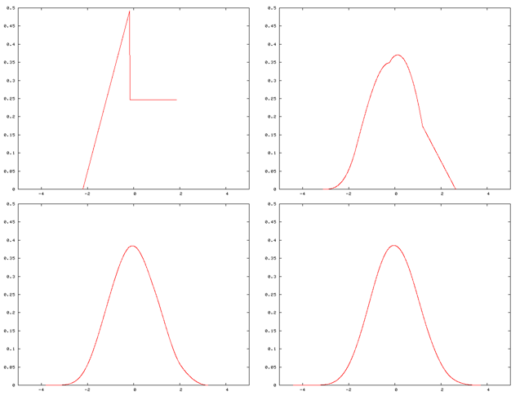
Central Limit Theorem

Slide 9
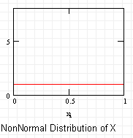
Central Limit Theorem

Slide 10
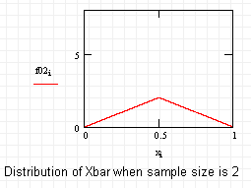
Central Limit Theorem

Slide 11
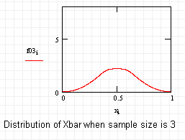
Central Limit Theorem

Slide 12
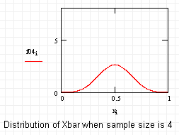
Central Limit Theorem

Slide 13
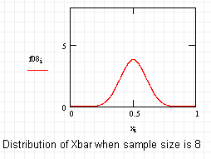
Central Limit Theorem

Slide 14
Central Limit Theorem
The CLT simply means that the distribution of an
average tends to be Normal, even when the
distribution from which the average is computed
is decidedly non-Normal.
The CLT is the foundation for many statistical
procedures, including Quality Control Charts,
because the distribution of the phenomenon under
study does not have to be Normal because its
average will be.
The normal distribution resulting from the averages
will have the same mean as the parent distribution,
AND, variance equal to the variance of the parent
divided by the sample size.

Slide 15
Examples
The heights of 1000 students are approximately normally
distributed with a mean of 174.5 cm and a standard
deviation of 6.9 cm. If 200 random samples of size 25
are drawn from this population and the means recorded
to the nearest tenth of a centimeter, determine
a) the mean and standard deviation of the sampling
distribution of X;
b) the number of samples means that fall between
172.5 and 175.8 cm?
c) the number of sample means falling below 172 cm

Slide 16
Examples
The random variable X, representing the number of cherries
in a cherry puff, has the following probability distribution:
X 4 5 6 7
P(X = x) 0.2 0.4 0.3 0.1
a) Find the mean μ and the standard deviation of X.
b) Find the mean μ_{X} , and the standard deviation σ_{X} of the
random variable X for random samples of
36 cherry puffs.
c) what is the probability that the average number of
cherries in 36 cherry puffs is less than 5.5?

